Slide 1

ROBOTIX CLUB NIT RAIPUR

Slide 2
Sponsorship Proposal
ROBOCON

Slide 3





We are a group of enthusiasts working our way out to decode the everyday evolving high-end technologies to build something for the betterment of human race
The Club established in July 2015 is one of the leading motivators for the technology addicts and robotics admirers in NIT Raipur
ABOUT US
Our mission is to make robotics an everyday phenomena and spread the knowledge about it

Slide 4


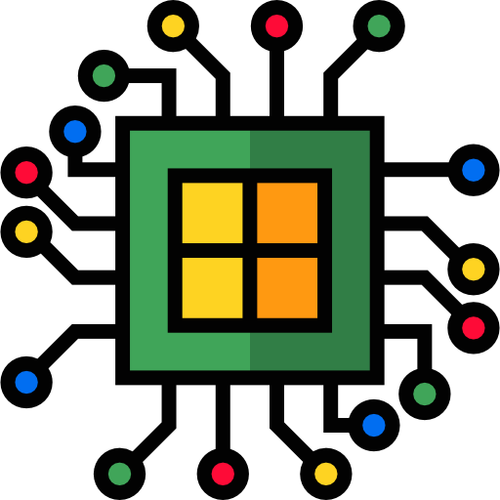

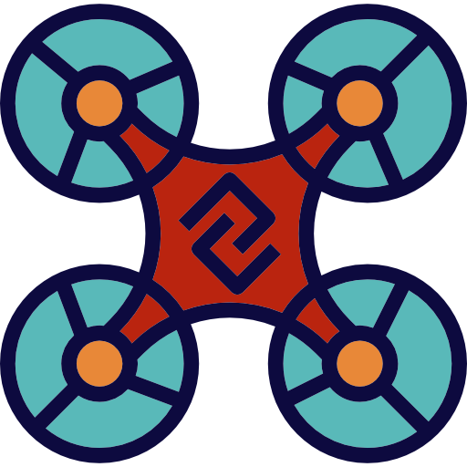

Workshops conducted by us
Manual Robotics
Autonomous Robotics
Brain Wave Robotics
IC Engine Overhauling
Drone Technology
PCB Design

Slide 5
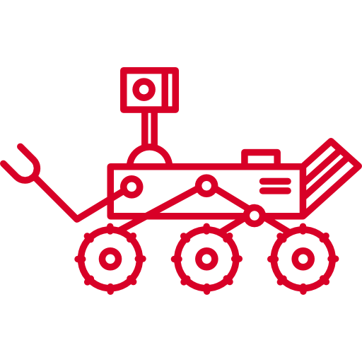






Our Events in AAVARTAN
Terrain Treader
Robo Shoot
Maze Runner
WORM
Diabolic Dumper
NIT Raipur’s Technical Fest

Slide 6


Trekkon (Weissenair)
Texas Instruments India Innovation Challenge
AHEC (Cognizance ‘15)
Poseidon (Cognizance ‘15)
Spazor
A-Maze-D (Technex ‘16)
Sensorous
Our Achievements

Slide 7

What is ABU Robocon?
ROBOCON is organized by the Asia-Pacific Broadcasting Unit (ABU).
It was started in 2002 and is presently the largest Robotics competition in the world with over 1500+ teams participating worldwide.
Every year the organization comes up with a new problem statement. The variation and the standard of problem statement gives ample opportunities to learn and implement various technical skills and inculcates managerial capabilities.
The team winning the national leg of the competition represents the country in the international stage.

Slide 8


What’s the Problem Statement
Teams of ABU Robocon 2018 are expected to design formidable robots and charismatic shuttlecocks showing their colours based on an interesting folk game called “Shuttlecock Throwing”.
If the shuttlecock makes it through the ring, the team gets points accordingly. The flying shuttlecock depicts a flying dragon, iconic of human power and the universe.

Slide 9
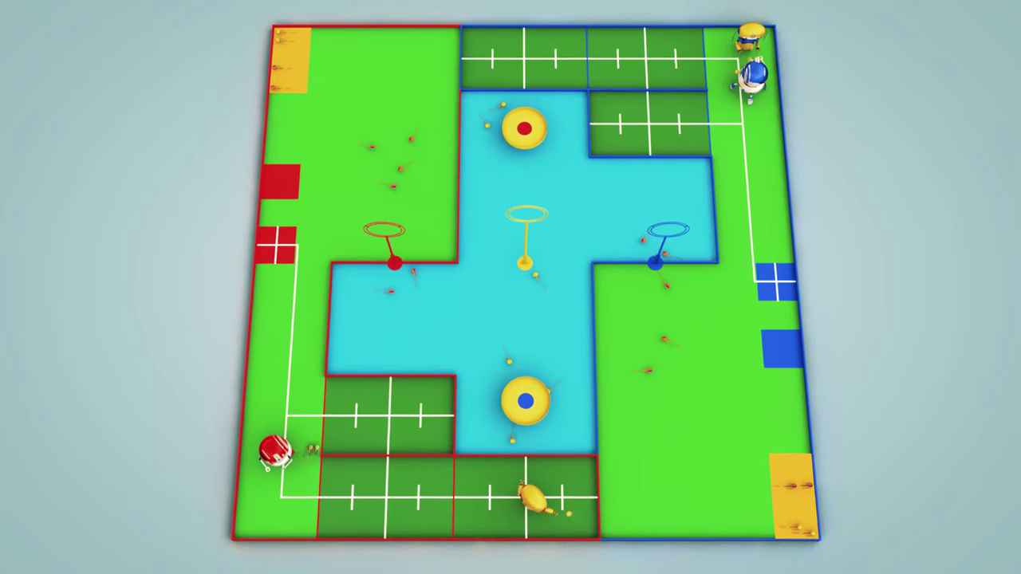

Slide 10



Budget
S. No. | Particulars | Amount
1. | Registration Fee | Rs 30,000
2. | Boarding and Lodging (for 4 days) being provided by the organiser on payment basis, i.e. Rs. 5,500 per person | Rs 5,500/- x 30 members = Rs 1,65,000/-
3. | Bot estimate: Manual and autonomous | Rs 1,50,000/-
4. | Travelling cost (Raipur to Pune) [ to & fro] | Rs 1,200/- x 30 members = Rs 36,000/-
Total |  | Rs 3,45,000/-

Slide 11
MANUAL ROBOT & AUTONOMOUS ROBOT
Materials | Price | Qty. | Total
Arduino Due | 3000 | 2 | 6000
Raspberry pi | 2800 | 1 | 2800
USB Camera | 2500 | 1 | 2500
IR array | 4000 | 2 | 8000
Limit Switch | 400 | 5 | 2000
Encoders | 500 | 2 | 1000
Eclectic actuator | 3500 | 3 | 10,500
BDC Motors | 4000 | 8 | 32000
BLDC Motors | 3000 | 2 | 6000
Al. Profile | 1000 | 15 | 15000
Motor Drivers | 2000 | 5 | 8750
Omni Wheel | 2500 +400 | 4 | 11,600
Magnum Wheel | 4000 +400 | 4 | 17600
Pixy Camera | 10000 | 1 | 10,000
Battery | 9000 | 2 | 18,000
PS2 Controller | 1500 | 1 | 1500
Total |  | Rs 1,53,250

Slide 12

Why Sponsor us?
NIT RAIPUR is one of the MOST PRESTIGIOUS INSTITUTE of Chhattisgarh.
To Earn VIVID PROMOTION of YOUR VENTURE at every WORKSHOP we organise.
ONLINE PUBLICITY on social networking portals like Facebook and Instagram.
ACKNOWLEDGEMENT in our OFFICIAL BROCHURE and WEBSITE.
PUBLICITY at on-site EVENTS.

Slide 13
THANK YOU

